Slide 1



PROJECT 1
FINANCE
PREDICTIVE ANALYSIS
PRESENTED BY:

Slide 2

TABLE OF CONTENTS
01
02
03
INTRODUCTION
METHODOLOGY
CONCLUSION
Problem statement
Aim and Objectives
Dataset Overview
Feature Visualization
Classification Models
Clustering Model
Results and Key Insights
Recommendations
Practical Application
2

Slide 3

01
INTRODUCTION
This presentation forms part of my final Loan Defaulter Prediction Model project, showcasing my data science skills within my portfolio.
Successfully completed as part of the Xaltius Data Science Course Internship, combining hands-on learning with real-world applications.
Tested 4 algorithms to find the most accurate model. Random Forest performed the best with an accuracy of 68.8%, while Decision Tree lagged with an accuracy of 32.4%.
The project encompasses every step of the data science process — from defining the problem to developing and evaluating predictive models.
A practical, data-driven approach to tackling real-world challenges in the financial sector!
3

Slide 4



PROBLEM STATEMENT
Bajaj FinServ need to evaluate borrower creditworthiness to minimize financial risk and maintain portfolio health.
AIM AND OBJECTIVE
Accurately classify borrowers as either defaulters or non-defaulters based on financial and demographic factors. .
CHALLENGE
OBJECTIVE
APPROACH
Identifying potential defaulters who are likely to fail in repaying debts
Build a predictive model to classify borrowers as defaulters or non-defaulters
Use machine learning to analyze historical financial and demographic data for accurate predictions.
4

Slide 5
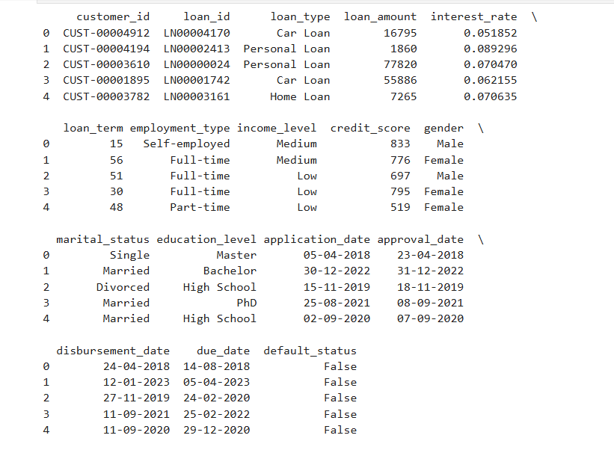
DATASET OVERVIEW
The dataset provided for this project is a subset of data from Bajaj FinServ, with certain columns deleted to adhere to privacy polices.
The dataset contains 5,000 entries and 17 columns including key columns such as loan_type, loan_amount, interest_rate and loan_term.
The dataset includes the following columns:
customer_id, loan_id: Unique identifiers for customers and loans.
loan_type: Types of loans (e.g., car loan, personal loan).
loan_amount, interest_rate, loan_term: Financial attributes of the loan.
employment_type, income_level, credit_score: Customer characteristics.
gender, marital_status, education_level: Demographic information.
application_date, approval_date, disbursement_date, due_date: Timeline attributes
.default_status: Target variable indicating if the customer defaulted (True) or not (False).
Image(1): Screenshot of first 5 entries in the dataset.
5

Slide 6
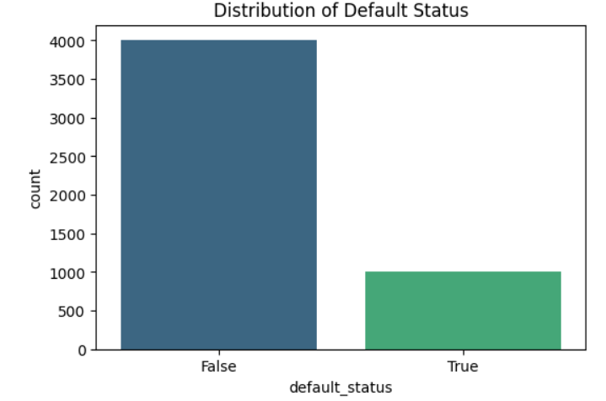
TARGET VARIABLE VISUALIZATION
Default Status:
The majority of borrowers (80%) are non-defaulters, while 20% are defaulters.
The default rates are manageable, but the 20% might raise concerns for stakeholders.
This indicates a need to analyse what factors (loan amount, loan term, interest rate or credit score) contribute to defaulting on loans.
The class imbalance is rectified for machine model
Image(2): Screenshot of target variable visualization.
6

Slide 7
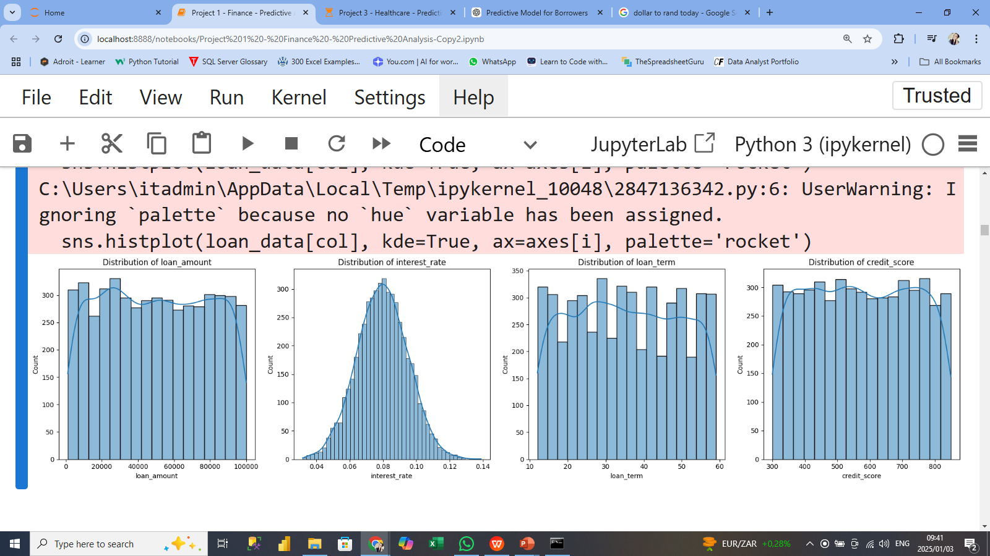
NUMERIC FEATURE VISUALIZATION
Loan Amount:
The drop near extremes suggests customers are less inclined to take very small or large loans or there may be a minimum threshold with loans capped at $100k.
Interest Rate:
The bell-shaped distribution indicates consistent risk pricing, with most clients receiving mid-range rates.
Loan Term:
Borrowers are spread evenly across available loan term options, indicating flexibility in loan structuring.
Credit Score:
A broad spectrum of credit scores are accommodated by the company indicating inclusivity in lending practices.
The drop-off at the lower and higher ranges could indicate groups that are under-served due to either risk concerns or limited demand.
Image(3): Screenshot of visualization of numeric features.
7

Slide 8
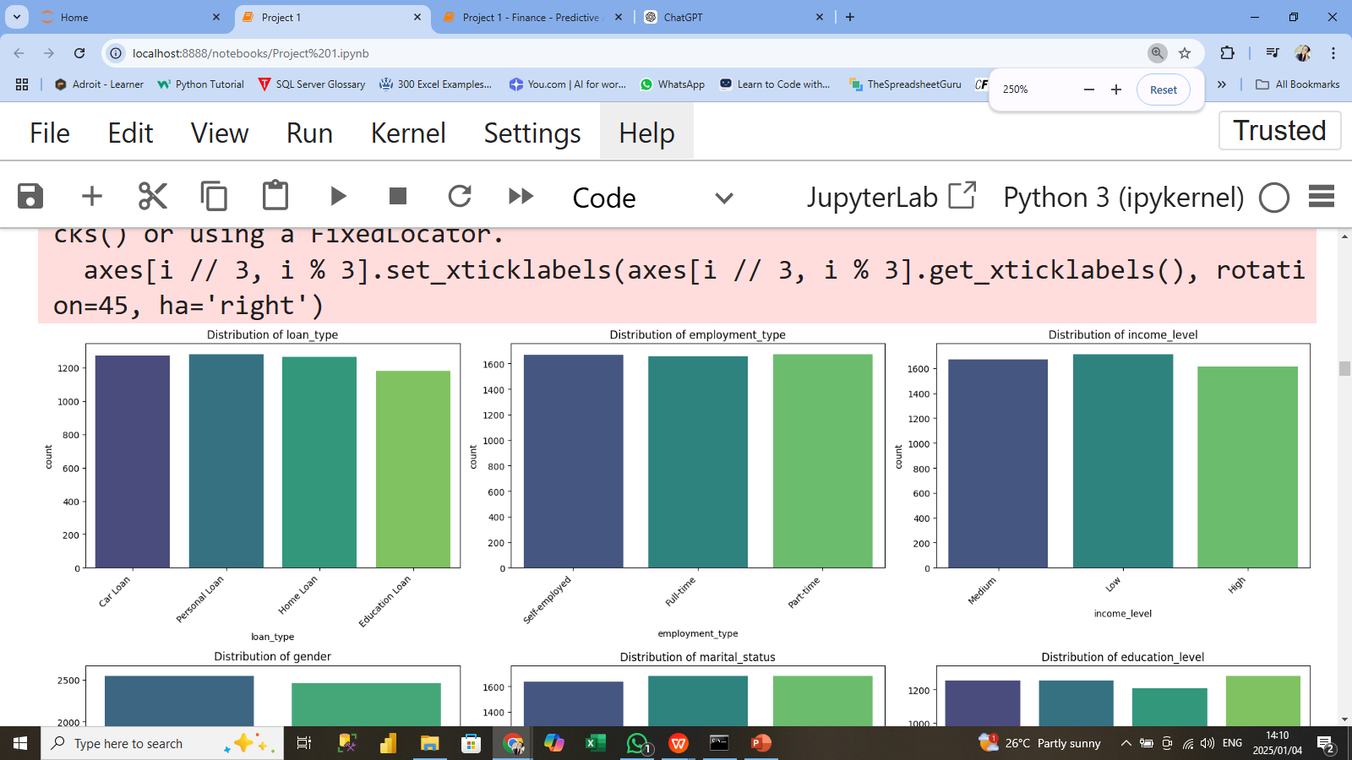
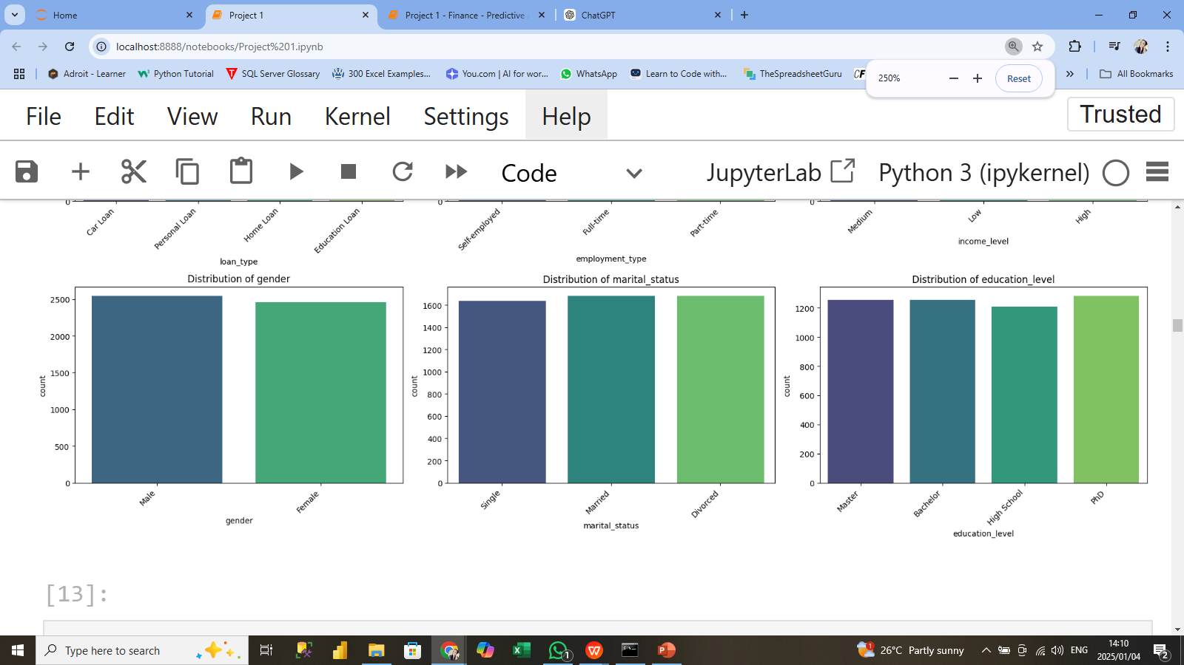
CATEGORICAL FEATURE VISUALIZATION
No imbalanced classes were identified that could bias the machine learning models.
Loan Type:
Diverse loan types, with Car, Personal, and Home loans being most common and Education slightly less common.
Employment Type:
Customers evenly split among employment types (Self-employed, Full-time, Part-time).
Income Level:
Balanced distribution across Low, Medium, and High incomes.
Gender:
Equal representation of Male and Female customers..
Marital Status:
Majority are Single or Married, with a slightly smaller proportion of Divorced individuals.
Education Level:
Most customers have a Master's, Bachelor's, or PhD, with fewer having only High-School education.
Image(4): Screenshot of visualization of categorical features.
8

Slide 9
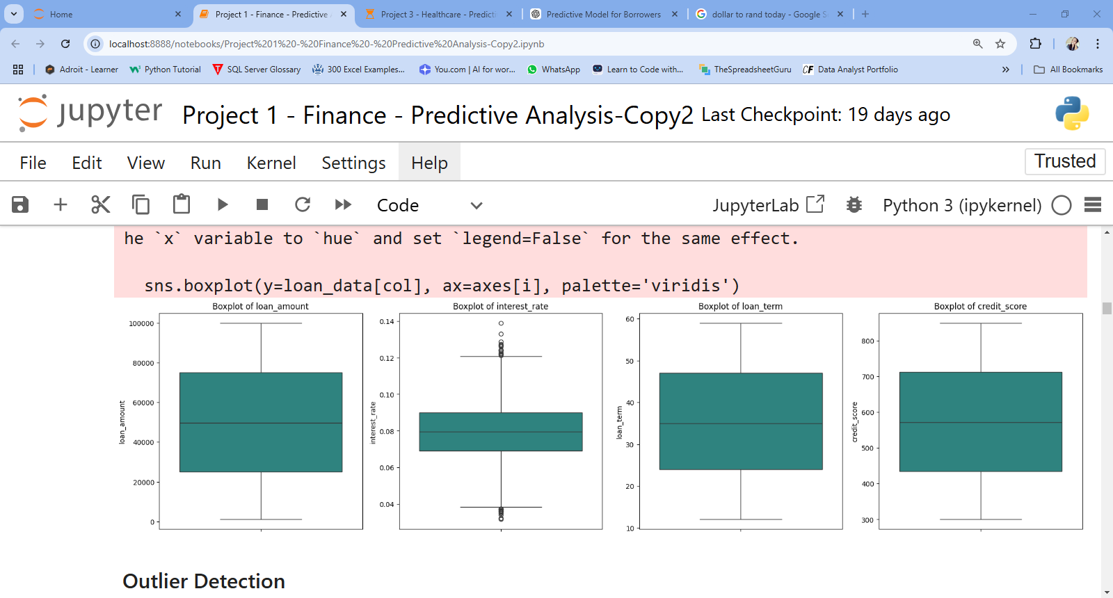
OUTLIERS VISUALIZATION
Interest Rate:
Several outliers are present on the higher and lower ends of the interest rates, particularly above 0.12 (12%) and below 0.04 (4%).
Outliers in higher ranges could signal high-risk clients, while lower rates could indicate prime clients or promotional offers.
Loan Amount, Loan Term and Credit Score:
There are no apparent or significant outliers and the data distribution is fairly uniform.
Image(5): Screenshot of visualization of outliers.
9

Slide 10
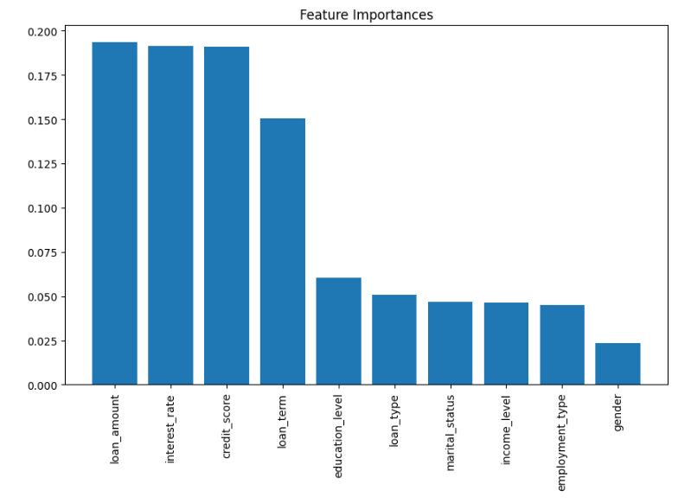
FEATURE IMPORTANCE
Tree-based models like Random Forest, allow us to analyze feature importance to understand which variables significantly influence predictions.
a) Loan Amount, Interest Rate, and Credit Score:
These are the most significant factors influencing the prediction of loan default.
Loan Amount: Larger loans might be harder for borrowers to repay, leading to higher default risks.
Interest Rate: Higher interest rates increase repayment burdens, impacting borrowers' ability to stay current on payments.
Credit Score: A lower credit score indicates a history of financial issues, which increases the likelihood of default.
b) Loan Term: The loan term (duration) also plays an important role. Borrowers with longer repayment periods might face more challenges in maintaining repayments over time.
Image(6): Screenshot of feature importance graph.
10

Slide 11

MACHINE LEARNING MODELS
Classification Models:
Supervised models for default prediction
Clustering Model:
Unsupervised model to uncover hidden patterns
11

Slide 12
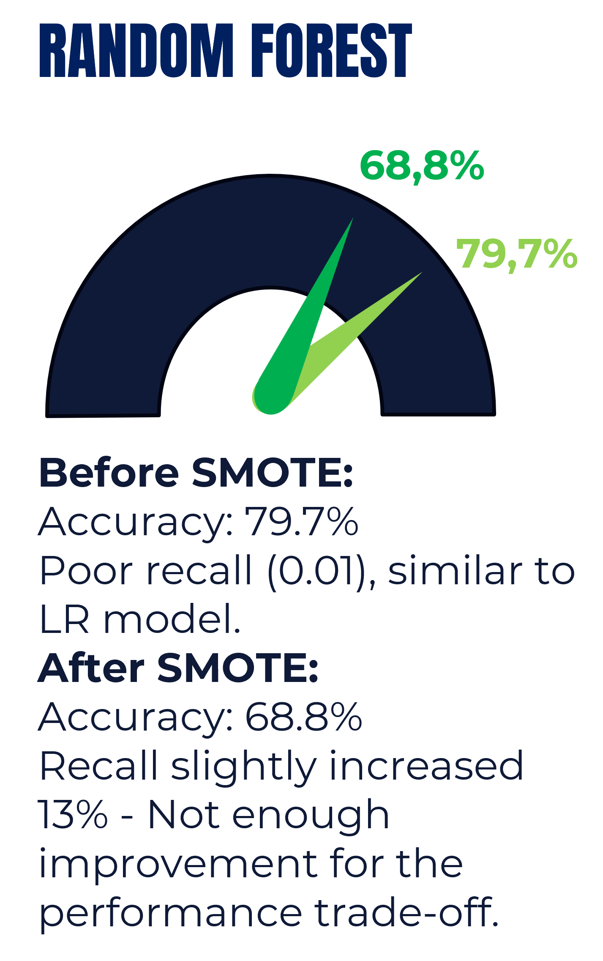
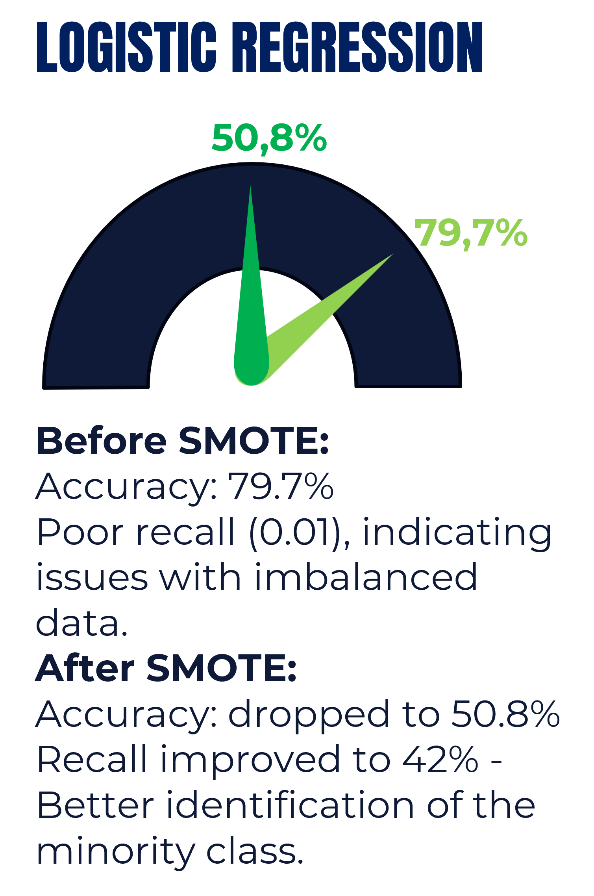
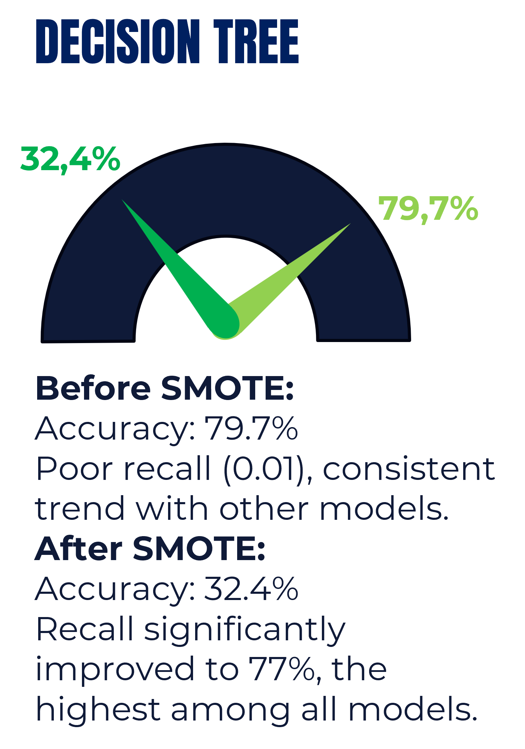
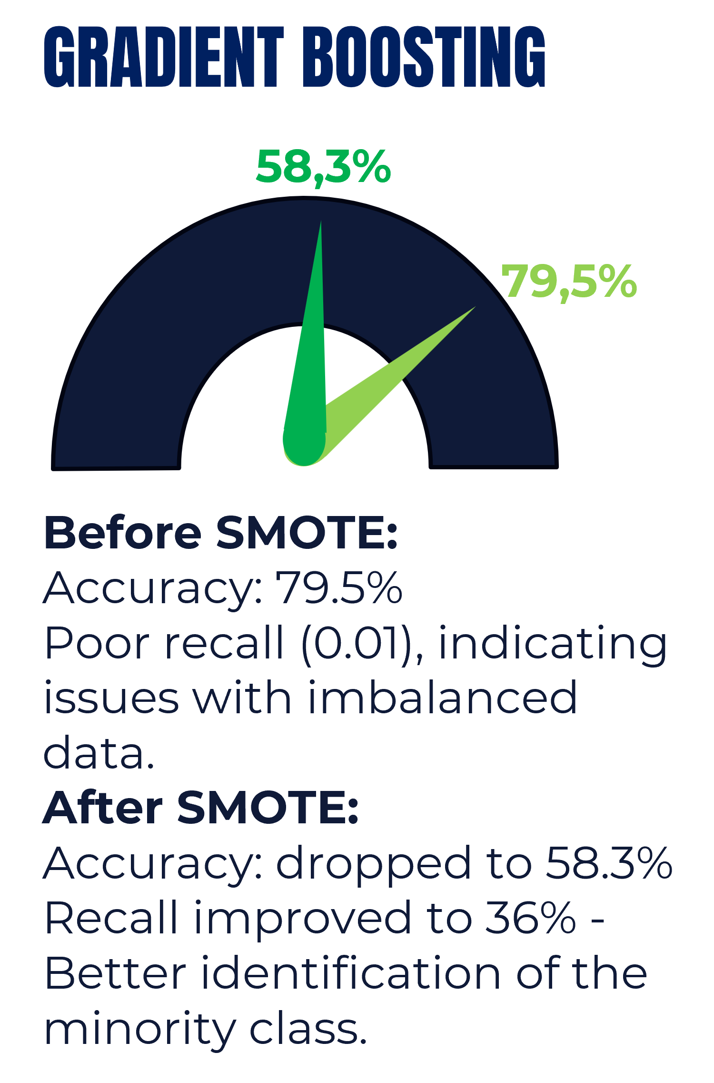
CLASSIFIER MODELS
Four (4) Machine Learning Models were trained, tested and evaluated using metrics like accuracy, precision, recall, and F1-score. The results were as follows:
12

Slide 13
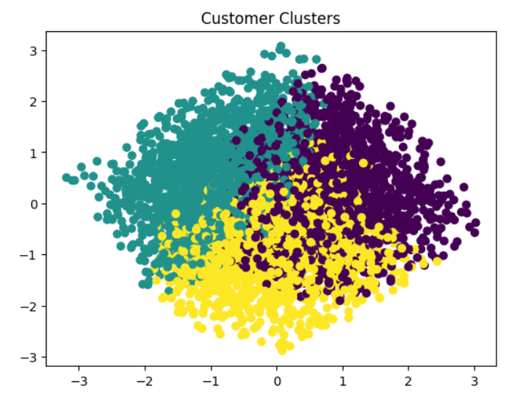
CLUSTERING MODEL
CLUSTERING PROFILES
Using the K-Means algorithm, to cluster similar customers, the dataset was successfully divided into 3 distinct clusters.
Cluster 0 – Teal:
Customers in this cluster have lower loan amounts and good credit score.
They also typically display shorter loan terms and medium to high interest rates.
Cluster 1 – Purple:
Consists of customers with higher loan amounts and low interest rates.
Tend to prefer longer repayment periods and tend to have lower credit scores.
Cluster 2 – Yellow:
Customers here prefer higher loan amounts with shorter repayment periods, indicating high purchasing power and financial discipline.
Although these customers possess stable repayment potential, they are also second most likely to default.
13

Slide 14

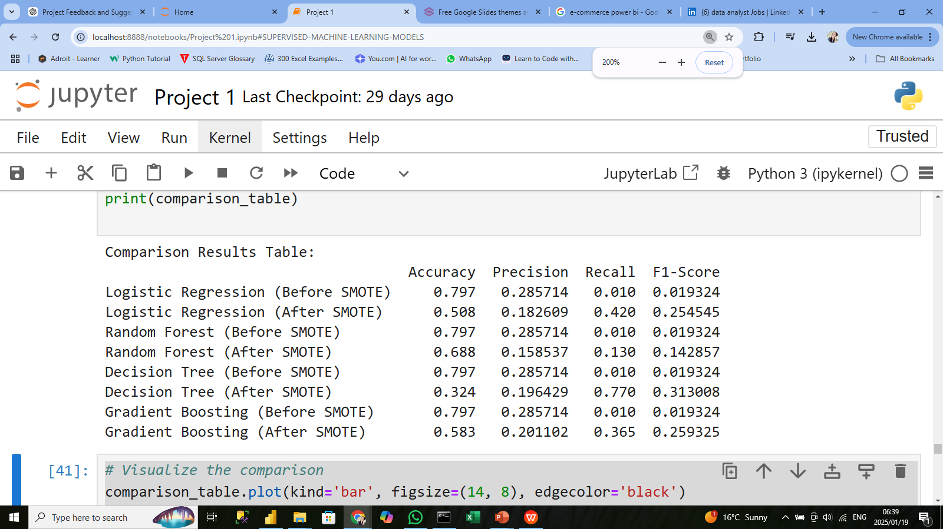
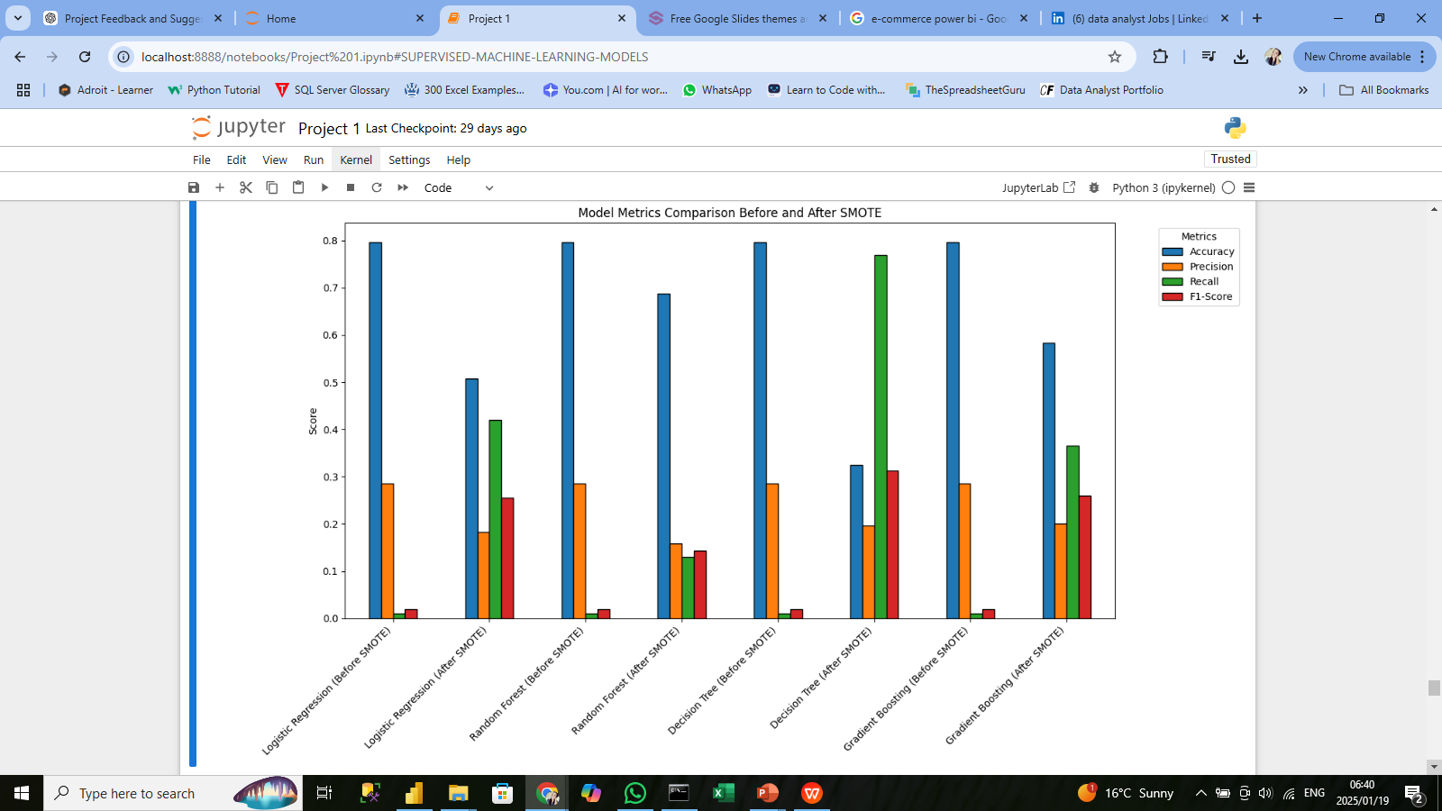
RESULTS AND FINDINGS
BEST MODEL:
Decision Tree (After SMOTE)
Recall: 0.770
F1-Score: 0.313
Most effective at identifying loan defaults.
KEY INSIGHTS:
Logistic Regression:
Performs poorly in both pre- and post-SMOTE scenarios.
Struggles with complex decision boundaries due to its linear nature.
Random Forest:
Moderate improvement after SMOTE.
Limited recall indicates challenges in handling imbalanced data.
Decision Tree:
Best recall after SMOTE, showcasing strong adaptability to imbalanced datasets.
Gradient Boosting:
Balances precision and recall well. Does not outperform Decision Tree in recall or F1-score.
14

Slide 15




PRACTICAL APPLICATIONS
LOAN DEFAULT RISK PREDICTION
Deploy the selected model (Decision Tree after SMOTE) to automate the identification of high-risk applicants for loan default.
FLAGGING HIGH-RISK APPLICANTS
Use the model predictions to flag applicants with high default risk for further manual review, ensuring early interventions.
DYNAMIC POLICY ADJUSTMENTS
Use cluster profiles to dynamically adjust lending policies based on risk profiles:
Offer lower interest rates or flexible repayment terms to low-risk clusters.
Require collateral or cosigners for high-risk clusters.
15

Slide 16

THANK YOU!
16

